Slide 1

Pedagogic Meeting
Meeting held on April 30th.

Slide 2
Topics
Students’ Score Assessment.
Strategies to Encourage Students to Keep on Attending Classes and Fostering Independence in Learners.
Class Strategies and Approaches.
General Issues

Slide 3
Students’ Score Assessment

Slide 4
Strategies to Encourage Students to Keep on Attending Classes and Fostering Independence in Learners.
Inside-outside Class Support
Tools
Skills
Goals
Connections
Orientation
Motivation
Confidence
Results

Slide 5


Goals
Helping students to establish their
goals ,to stick with and follow them.
Long term goals x short term goals.
“What is my goal in taking this class?”
“What am going to take out of it?”

Slide 6
Seeing one’s own progress. Another essential factor in creating irresistible instruction is enabling students to see their own progress. Students who see concrete success are enthusiastic about studying English, and nothing motivates like success. In a recent study by
the National Center for the Study of Adult Learning and Literacy (NCSALL), two of the three supports to learner persistence demonstrated in adult learners were establishment of a goal by the student and progress toward reaching a goal.
To provide students with that support, students should have an opportunity in each class session to understand the goal and observe their achievement of the goal. Goals must be stated, and all presentations, exercises, and activities that follow should contribute obviously to the achievement of the goal.

Slide 7

Making clear to students that the purpose of a certain unit is not to the language tools but in fact the practical and social use of that new input.
Encouraging class community.

Slide 8

Fostering students’ independence.
Developing skills in the class to enable students to continue studying outside the classroom.
Stimulating good study habits, good studies skills, helping students to organize their books, vocabulary memorization techniques, working with dictionaries, etc.

Slide 9
“Helping learners find quality “homework” is essential to maintain quality learning in the classroom. The ideas are endless: direct students to quality language learning websites (or build your own, as many teachers have done), make available quality audio, video, and multimedia learning sources, develop a small library of accessible readers and supplementary materials and self-access quizzes, worksheets and games. Spending classroom time to help students select, share, and evaluate their out-of-class work with English is just as important as covering a lesson in the textbook. Helping students “change their reality means moving them toward seeing language learning in a different way. It means helping them take simple, self-directed steps to make choices about learning.” Michale Rost- EFL and ESL teacher and Pearson Longman consultant.

Slide 10
Structure and Sequence
“It's time to stop blaming adult learners for failing to attend classes regularly because they live adult lives. We need to admit that many learners will have difficulty attending classes consistently and completing programs on schedule. At the same time, we need to take advantage of their persistence and determination.”
Predictable routine.

Slide 11
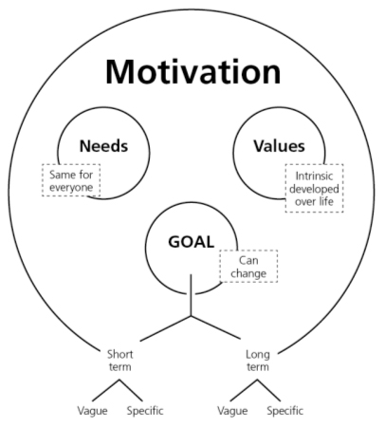
Needs
Values
Same for everyone
Intrinsic
developed
over life
Goals
Can change
Short
term
Long
term
Vague
Specifc
Vague
Specifc

Slide 12
The research on motivation defines motivation as an orientation toward a goal. (This orientation may be positive, negative, or ambivalent.) Motivation provides a source of energy that is responsible for why learners decide to make an effort, how long they are willing to sustain an activity, how hard they are going to pursue it, and how connected they feel to the activity.

Slide 13
Because igniting and sustaining a source of positive energy is so vital to ultimate success, everything the teacher does in the language classroom has two goals. One is, of course, to further language development, and the other is to generate motivation for continued learning. Much of the research on motivation has confirmed the fundamental principle of causality: motivation affects effort, effort affects results, positive results lead to an increase in ability. What this suggests, of course, is that by improving students’ motivation we are actually amplifying their ability in the language and fueling their ability to learn.

Slide 14
What specific approaches can teachers take to generate
motivation?
The three levels or layers of motivation in language learning:
The first layer of motivation: Finding your passion.
The second layer of motivation: Changing your reality.
The third layer of motivation: Connecting to learning
activities

Slide 15

Seating Arrangement

Slide 16

Breaking Bad Teaching Habits

Slide 17
Class Strategies and Approaches.
Pairwork / Groupwork
Reading Aloud
Checking Understanding
Pronunciation
Speaking to Other Students
in English
Guessing Answers
Stopping an Activity
Feedback
Dealing with Vocabulary Queries
Monitoring
Error Correction
Eliciting
Checking Together
Reading before Writing
Brainstorming
Personalizing
Translating
Pacing
Concept Checking
Using Dictionaries
20 Teaching Tips By Liz Regan’s – TEFL.net

Slide 18
Positive Teaching Habits
Student central approach
Organization
Positiveness
Use of L2
Appropriacy
Clear explanations
Flexibility
Adequacy

